Slide 1
ROCO218: Control Engineering Dr Ian Howard Lecture 8 Transfer function of a SFC system

Slide 2
Transfer functions of SFC system
Given the state space equations
We showed previously that the transfer function of this state space model is given by the expression
So assuming D is zero we have

Slide 3
Transfer functions of SFC system
As we know, by applying full state feedback leads to the relations
The SFC gain K effectively changes the A matrix
Therefore we can modify the transfer function G(s) accordingly
So the transfer function for the state space system
Becomes

Slide 4
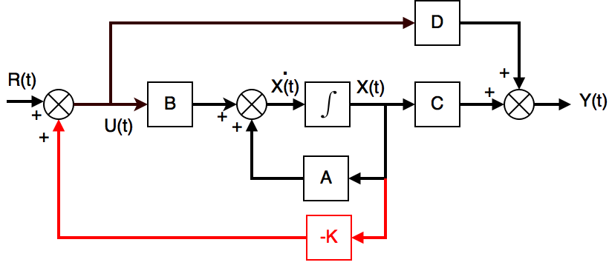
Effect of transfer function on reference input
The reference input R(t) will be processed by the SFC system
To achieve good tracking of the reference input we require that
as
Driving the system with a unit step input, we require the output to be unity
To achieve this we need to scale the reference input by a gain

Slide 5
Effect of transfer function on reference input
Using the final value theorem, we require that time output driven by step lends to unity
So to achieve this we will scale the input so that
Substituting in the transfer function for the SFC system
This leads to an expression for the scaling
We need to scale the reference input by this value to ensure unity DC gain of the SFC system

Slide 6
ROCO218: Control Engineering Dr Ian Howard Lecture 8 Integral action

Slide 7
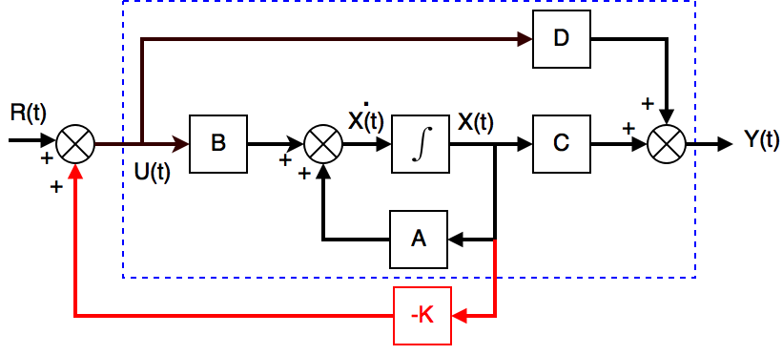
State space feedback control
Scaling the input reference a good practice to ensure output reaches the input target
However with pure SFC we do not make use the system output Y(t)!
If we don’t use the output, the system will need to be calibrated to operate well
Therefore requiring we have an exact process model is undesirable!

Slide 8
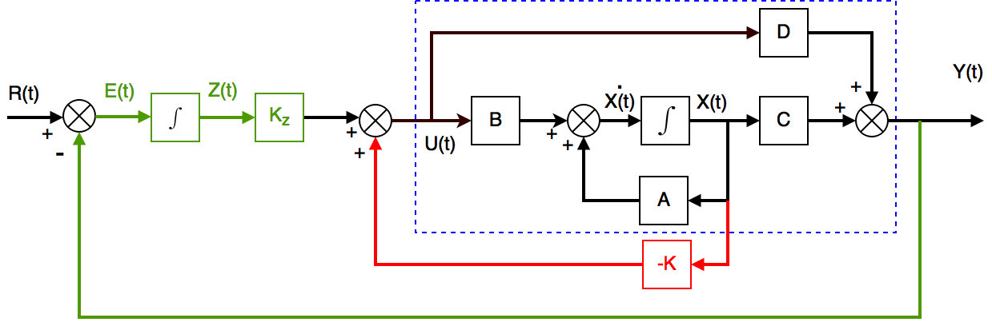
Integral action
Remember one of the primary uses of feedback is to allow good performance in the presence of uncertainty!
So we can use integral feedback to make use of the output
Here the controller uses an integrator to achieve zero steady state error
To achieve integral feedback we create a state within the controller that computes the integral of the error signal
This is is then used as a feedback term as denoted by the green path on the schematic above

Slide 9
Integral action
To achieve integral feedback we augment the system by adding another state Z
The state Z is the integral of the error between the desired output R(t) and actual output Y(t)
Thus the standard state space equation
augmented with the state Z becomes
Using feedback control if the augmented state we see that

Slide 10
Remember: velocity control inverted pendulum
Given the equation
Let the constant terms be represented by the coefficients
Choosing state space representations

Slide 11
Remember: Velocity control inverted pendulum
From the state space representation of the velocity controlled inverted pendulum
Where output y is the pendulum angle θ

Slide 12
Remember: Augmented velocity control inverted pendulum
In practice we can to control cart position as well as angle and angular velocity!
Otherwise it might never stop moving!
To do so we can add a third state x₃ to represent cart position
Since the control signal is cart velocity, the differential of x₃ is simply given by the input velocity control signal
Therefore we can write

Slide 13
Adding integral action to the VCIP
We now want to use the cart position to generate error integrated over time
To do so we can add a fourth state x₄ to represent integrated cart position error
To achieve this we further augment the system matrices
Notice we update the integral state by selecting the position state x₃ to generate the (y-r) term used for integral action
Here we assume the reference value is zero
We didn’t change y to implement this

Slide 14
Adding integral action to the VCIP
Substituting in the coefficients leads to the equations
Finally we can design the feedback gain vector K needed to implement full feedback state control using the Matlab place command

Slide 15
ROCO218: Control Engineering Integral control exam solutions

Slide 16
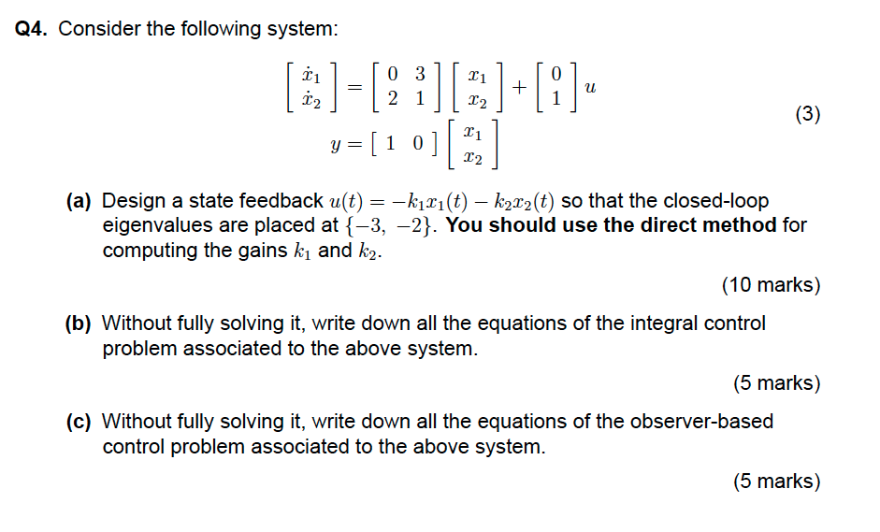
Q4: SFC, integral control and observer

Slide 17
Q4: SFC, integral control and observer
For system
Full state feedback requires that
So system equations become

Slide 18
Q4: SFC, integral control and observer
From state space system

Slide 19
Q4: SFC, integral control and observer
We require that the eigenvalues λ of the controller system are at -3,-2
This means we will want the following characteristic equation for the eigenvalues
The eigenvalues λ of the closed loop system are given by
Substituting in values for B we have

Slide 20
Q4: SFC, integral control and observer
So e expanding
This gives the characteristic equation for the system
We now need to match the coefficients in the desired eigenvalues characteristic equation using the appropriate gain vector K
We want the characteristic equation

Slide 21
Q4: SFC, integral control and observer
Integral action can be implemented by introducing another state z in the system such that
For a pure state feedback system
Adding in the additional state for integral action this leads to he expression
We also amend the feedback control to include weighted contributions from the state z

Slide 22
Q4: SFC, integral control and observer
An observer can be used to estimate system state using efference copy of the motor command
To make the process, robust the output from the system can also be used to correct the state estimate
For the plant of the system
For state estimator
Where matrix 2x2 L represent a scaling of the error between actual and predicted output
To ensure the estimator is stable and initial conditions decay away, it is necessary to choose L such that the expression
Has eigenvalues with negative real parts
The feedback control is given by

Slide 23
ROCO218: Control Engineering Dr Ian Howard Lecture 8 Optimal control

Slide 24
Remember: State feedback control
We showed previously state feedback control provides a means to move the eigenvalues of a system from their open loop values
In an open loop state space system
Substituting in state feedback as input
Gives rise to the closed loop system
Stability determined by location of poles which are the eigenvalue of matrix A
Stability determined by location of poles which are the eigenvalue of matrix (A-BK)

Slide 25
Remember: State feedback control
The corresponding signal flow graph is shown below
When a system is fully controllable its eigenvectors poles can be placed arbitrarily by choosing the value of K
But how to place poles is often not obvious!
Therefore a more principled methods to choose K is often useful

Slide 26
Optimal control
Instead of direct pole placement, optimal control makes use of a performance criterion
To do so we define a ‘cost function’ which lets us minimize some quantity of the control process
For example imaging we a driving a car:
We could minimize the time required to go from A to B
= Final Time
We could minimize the fuel used to go from A to B
= Fuel Used
We could minimize the financial cost to go from A to B
= £ Cost of trip

Slide 27
Optimal control
Often a quadratic performance measure is adopted
To make analysis easier
leads to well behaved solutions
The term
Where typically
Is the weighted square distance of state from its origin
Affects convergence rate: rise time and settling time
Large Q means get good tracking as expense of large input
The term
Is the weighted square of control input activity
Penalizes large and aggressive inputs
Large R means little input needed at expense of good tracking
We need to optimize the performance index for the given state space system

Slide 28
Optimal control
From the expression for cost
We want to find the corresponding gain K that minimizes J
The solution by dynamic programming
This leads to the expression for the optimal gain
where R is invertible and P is symmetric and satisfies the algebraic Riccati equation

Slide 29
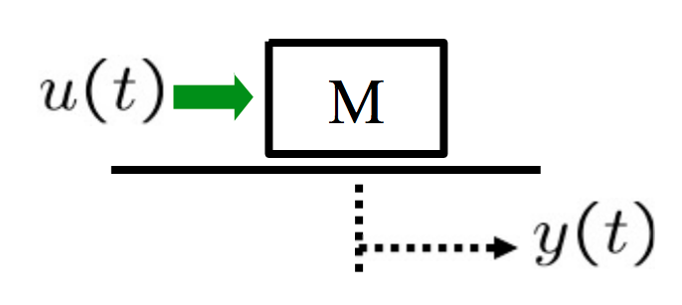
Example: Force optimal control of mass position
Consider control of a 1Kg mass.
Since f = ma
Defining the two state variables
Therefore
Writing in state space notation we have

Slide 30
Example: Force optimal control of mass position
We want to find optimal control that minimizes
This can be formulated as an LQR problem with
and
To solve the minimization problem, we first solve the algebraic Riccati equation:
Since we have a 2x2 A matrix, we solve for the matrix P which is symmetric Matrix with the following entries:

Slide 31
Example: Force optimal control of mass position
Substituting in the system matrices algebraic Riccati equation becomes
Evaluating terms

Slide 32
Example: Force optimal control of mass position
Evaluating terms

Slide 33
Example: Force optimal control of mass position
So therefore
Thus the elements of the matrix must be zero

Slide 34
Example: Force optimal control of mass position
Solving the equations
will have P positive definite (P > 0), if and only if p1 > 0 and det(P) > 0

Slide 35
Example: Force optimal control of mass position
the expression for the optimal gain

Slide 36
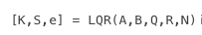
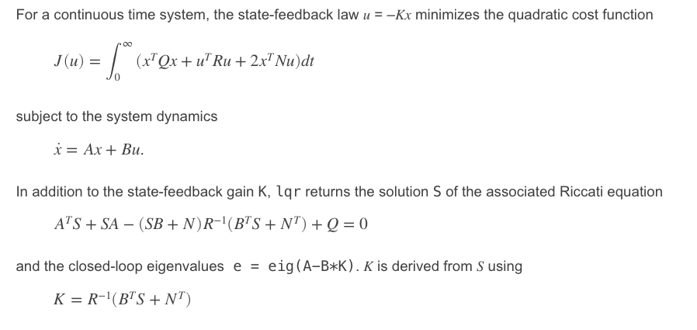
Optimal control gain design using Matlab
In Matlab the optimal gain can be found using the lqr command
The Matlab document page is as follows:

